Slide 1
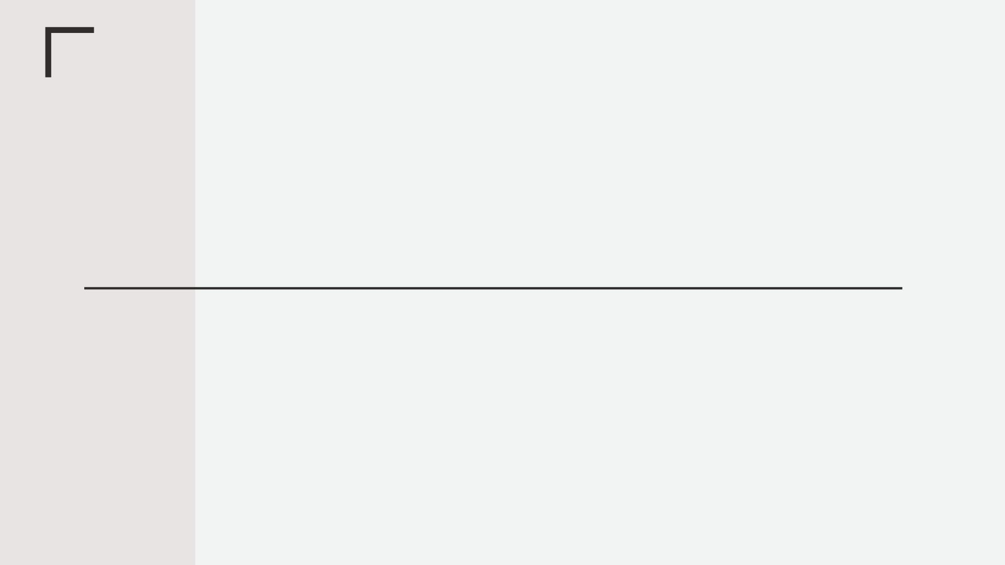
Spring MVC
What is Spring MVC?
• Framework for building web applications in Java • Based on Model-View-Controller design pattern • Leverages features of the Core Spring Framework (IoC, DI)

Slide 2
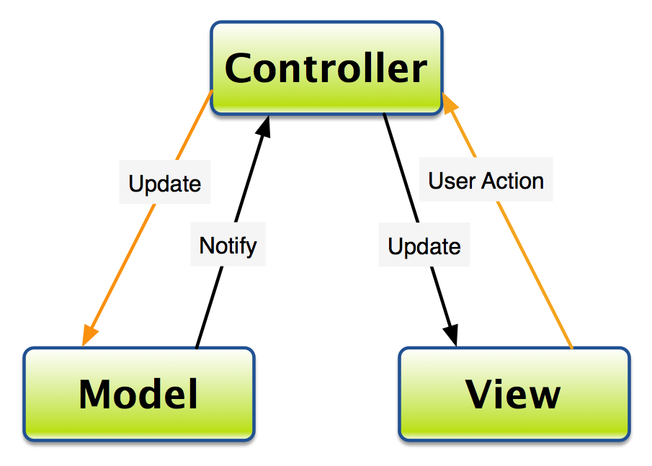
MVC – Modal View Controller

Slide 3
Spring MVC Front Controller
• Front controller known as DispatcherServlet • Part of the Spring Framework • Already developed by Spring Dev Team
You will create • Model objects • View templates • Controller classes
• Front controller known as DispatcherServlet • Part of the Spring Framework • Already developed by Spring Dev Team
• Front controller known as DispatcherServlet • Part of the Spring Framework • Already developed by Spring Dev Team
• Front controller known as DispatcherServlet • Part of the Spring Framework • Already developed by Spring Dev Team

Slide 4
Spring MVC Front Controller
Controller
• Code created by developer
• Contains your business logic • Handle the request • Store/retrieve data (db, web service…) • Place data in model
• Send to appropriate view template

Slide 5
Model
• Model: contains your data
• Store/retrieve data via backend systems • database, web service, etc… • Use a Spring bean if you like
• Place your data in the model • Data can be any Java object/collection
View Template • Spring MVC is ﬂexible • Supports many view templates
• Most common is JSP + Thymeleaf + Velocity + Freemaker
• Developer creates a page • Displays data

Slide 6
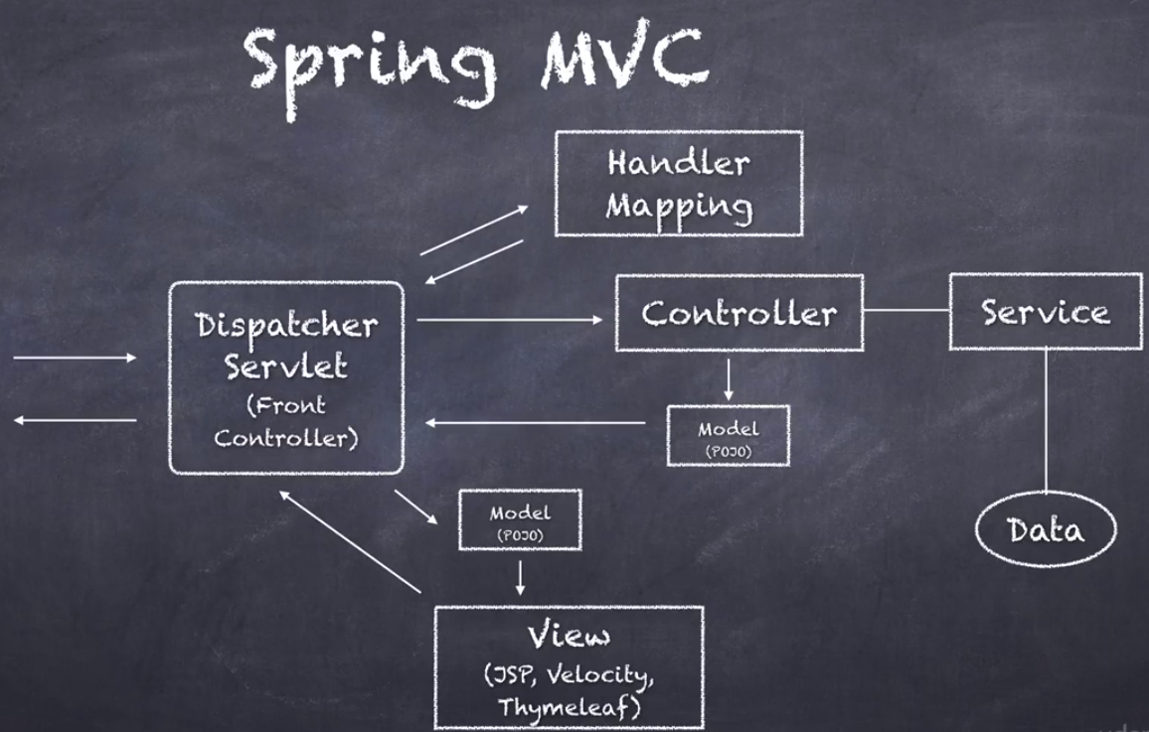
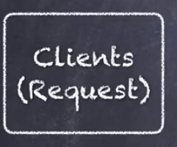
Spring MVC – Modal View Controller

Slide 7
Spring MVC Benefits
• The Spring way of building web app UIs in Java • Leverage a set of reusable UI components • Help manage application state for web requests • Process form data: validation, conversion etc • Flexible conﬁguration for the view layer

Slide 8
Spring MVC Behind the Scenes
Components of a Spring MVC Application
• A set of web pages to layout UI components
• A collection of Spring beans (controllers, services, etc…)
• Spring conﬁguration (XML, Annotations or Java)

Slide 9
Development Environment
Apache Tomcat Eclipse (Java EE version) Connected Eclipse to Tomcat
Additional Things To Do
Download latest Spring JAR ﬁles from Spring website

Slide 10
Developing Spring Controllers and Views
Development Process for Request Path: /
1. Create Controller class
2. Deﬁne Controller method
3. Add Request Mapping to Controller method
4. Return View Name
5. Develop View Page
Step 1: Create Controller class
• Annotate class with @Controller
• @Controller inherits from @Component … supports scanning
@Controller public class HomeController {
}

Slide 11
Step 2: Define Controller method
@Controller
public class HomeController {
public String showMyPage() {
… }
}
Step 3: Add Request Mapping to Controller method
@Controller public class HomeController { @RequestMapping("/") public String showMyPage() { … }
}
Step 4: Return View Name
@Controller public class HomeController { @RequestMapping("/") public String showMyPage() { return "main-menu"; } }

Slide 12
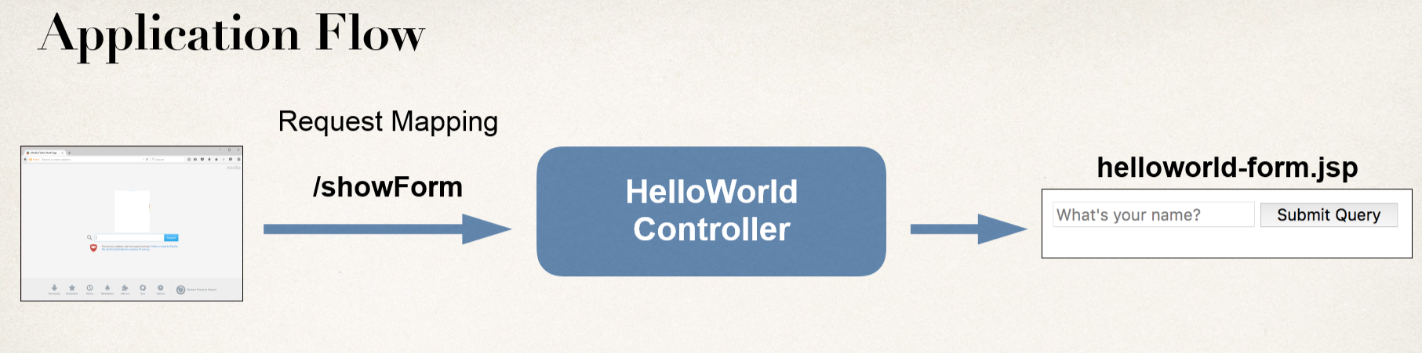
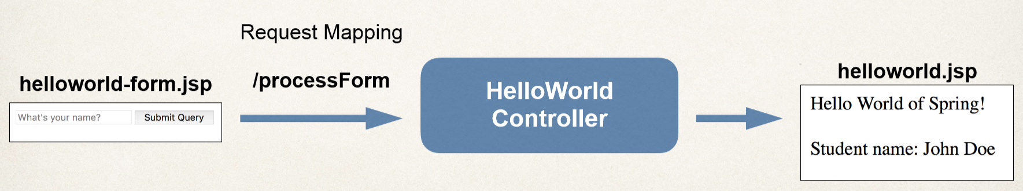
Reading Form Data with Spring MVC

Slide 13
Controller Class
@Controller public class HelloWorldController { // need a controller method to show the initial HTML form @RequestMapping("/showForm") public String showForm() { return "helloworld-form"; } // need a controller method to process the HTML form @RequestMapping("/processForm") public String processForm() { return "helloworld"; } }

Slide 14
Adding Data to Spring Model
Spring Model:
• The Model is a container for your application data
• In your Controller
• You can put anything in the model
• strings, objects, info from database, etc…
• Your View page can access data from the model
Passing Model to your Controller:
@RequestMapping("/processFormVersionTwo") public String letsShoutDude(HttpServletRequest request, Model model) { String theName = request.getParameter("studentName"); theName = theName.toUpperCase();
String result = "Yo! " + theName;
model.addAttribute("message", result);
return "helloworld";
}

Slide 15
View Template: Accessing data from the model
<html>
<body>
Hello World of Spring! ... The message: ${message}
</body>
</html>

Slide 16
Reading HTML Form Data with @RequestParam Annotation
Code Example
• We want to create a new method to process form data
• Read the form data: student’s name
• Convert the name to upper case
• Add the uppercase version to the model
Bind variable using @RequestParam Annotation
@RequestMapping("/processFormVersionTwo") public String letsShoutDude( @RequestParam("studentName") String theName, Model model)
{
// code
}

Slide 17
Add Controller @RequestMapping
Adding Request Mappings to Controller
• Serves as parent mapping for controller
• All request mappings on methods in the controller are relative
• Similar to folder directory structures
Controller Request Mapping
@RequestMapping("/funny") public class FunnyController { @RequestMapping("/showForm") public String showForm() { ... } @RequestMapping("/processForm") public String process(HttpServletRequest request, Model model) { ... }
}

